Slide 1
Welcome to
Upper Room Church
Health Expo & Seminar Series
Summer of Evangelism

Slide 2
Day 4
Thursday 29th August
Choose to live longer, better ABUSE/MENTAL HEALTH & FAMILY LIFE

Slide 3
Definition of mental health
The World Health Organization defines health as:
‘ …a state of (complete) physical, mental and social well-being and not merely the absence of disease or infirmity.’
Mental health is: ‘…the emotional and spiritual resilience which allows us to enjoy life and survive pain, disappointment and sadness. It is a positive sense of well-being and an underlying belief in our own, and others’, dignity and worth.’
(Health Education Authority 1997)
7
Notes:
Mental health influences how we think and feel about ourselves and others and how we interpret events. It affects our capacity to learn, to communicate and to form, sustain and end relationships. It also influences our ability to cope with change, transition and life events: having a baby, moving house, experiencing bereavement. (Friedli 2004)

Slide 4
Health and Wellness
Health is the state of well-being in which all of the components of health are in balance
Wellness is broken down into six major categories
To be truly healthy; You must take care of all six components

Slide 5
The Six Components of Health
Physical
Social
Environmental
Emotional
Spiritual
Intellectual/Mental

Slide 6
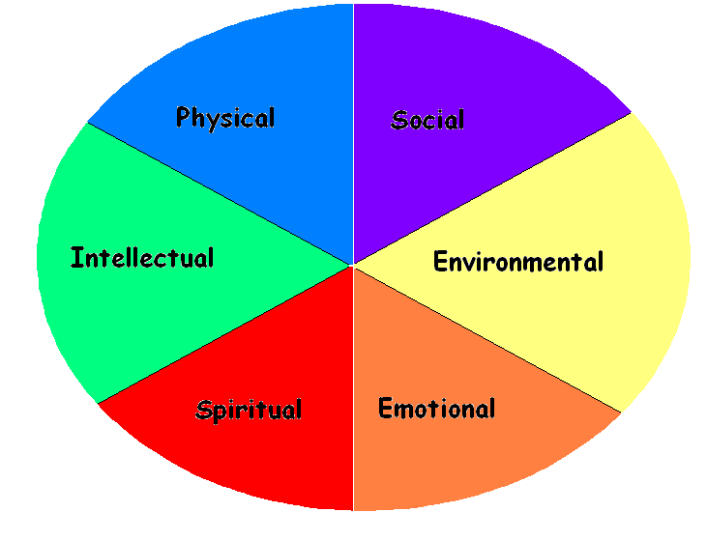
The Wellness Wheel Complete

Slide 7
No health without mental health
A cross-government mental health outcomes
strategy for people of all ages
The Prime Minister, David Cameron, and the
Deputy Prime Minister, Nick Clegg, have made
it clear that the Coalition Government’s success
will be measured by the nation’s wellbeing, not
just by the state of the economy.

Slide 8
The costs of mental health problems to the
economy in England have recently been
estimated at a massive £105 billion, and
treatment costs are expected to double in the
next 20 years.
We simply cannot continue to allow costs to spiral upwards

Slide 9
This Government recognises that our mental
health is central to our quality of life, central to
our economic success and interdependent with
our success in improving education, training and
employment outcomes and tackling some of the
persistent problems that scar our society, from
homelessness, violence and abuse, to drug use and crime

Slide 10
The mental health continuum
• No absolutes
Maximum mental wellbeing
• The continuum . . .
A person with a diagnosis of a serious illness but who copes well and has positive mental health
A person with no illness or disorder and positive mental health
Maximum mental illness/
disorder
Minimal mental illness/
disorder
A person with a diagnosis of a serious illness and who has poor mental health
A person with no diagnosable illness or disorder but who has poor mental health
Minimal mental wellbeing
8
Notes:
The horizontal axis is the best place to fit medical language. The vertical axis is the best place for social language

Slide 11
Preventing mental health problems
We can improve our mental health by:
increasing awareness
increasing protective factors and reducing risk factors where possible
promoting positive coping strategies
9
Notes:
Protective factors:
Life skills
Parenting
Self belief
Confidence
Problem solving
Communication
Coping skills
Conflict resolution
Respectful relations
Emotional literacy
Values and beliefs
Community engagement / physical health
Tolerant community
Meaningful activity
Social network
Arts & culture
Homes
Positive parenting
Physical activity
Nutrition
Rest and reflection
Risk factors:
Individual
Alcohol
Drugs
Smoking
Abuse
Traumatic life events
Prison
Poor parenting
Lack of support
Illness
Genes
Societal
Poverty
Unemployment
Poor education
Poor housing
Community violence
Disempowering services
Discrimination
Ethnicity
Gender
Disability
Homophobia
Age
What is Well-being?
Being at ease with oneself
Having a sense of purpose, meaning and fulfilment
Experiencing positive emotions and having the resilience to deal with life’s difficulties
Belonging to a respectful community
The above is taken with thanks from “A Dynamic Model for Well-Being”, Nurse J, Campion J, Sheehan D, 2006
5 ways to well-being: Connect..., Be Active...,Take Notice...,Keep Learning...,Give...
Extract from www.neweconomics.org – the website of the New Economics Foundation (nef):
In 2008, nef (New Economics Foundation) was commissioned by the UK Government's Foresight Project to review the inter-disciplinary work of over 400 scientists from across the world. The aim was to identify a set of evidence-based actions to improve well-being, which individuals would be encouraged to build into their daily lives.
As an illustration of how government action can be explicitly directed towards improving well-being, the following briefly sets out the five evidence-based ways to well-being and the sorts of policy interventions which could help to enable them.
Connect... Social relationships are critical to our well-being. Survey research has found that well-being is increased by life goals associated with family, friends, social and political life and decreased by goals associated with career success and material gains. Governments can shape policies in ways that encourage citizens to spend more time with families and friends and less time in the workplace. For example, employment policy that actively promotes flexible working and reduces the burdens of commuting, alongside policies aimed at strengthening local involvement, would enable people to spend more time at home and in their communities to build supportive and lasting relationships.
Be Active... Exercise has been shown to increase mood and has been used successfully to lower rates of depression and anxiety. Being active also develops the motor skills of children and protects against cognitive decline in the elderly. Yet for the first time in history more of the world's population live in urban than non-urban environments. Through urban design and transport policy, governments influence the way we navigate through our neighbourhoods and towns. To improve our well-being, policies could support more green space to encourage exercise and play and prioritise cycling and walking over car use.
Take Notice... In the US, research has shown that practising awareness of sensations, thoughts and feelings can improve both the knowledge we have about ourselves and our well-being for several years. But the twenty-first century's never-ending flow of messages from companies advertising products and services leaves little opportunity to savour or reflect on our experiences. Policy that incorporates emotional awareness training and media education into universal education provision may better equip individuals to navigate their way through the information super-highway with their well-being intact; regulation to create advertising-free spaces could further improve well-being outcomes.
Keep Learning... Learning encourages social interaction and increases self-esteem and feelings of competency. Behaviour directed by personal goals to achieve something new has been shown to increase reported life satisfaction. While there is often a much greater policy emphasis on learning in the early years of life, psychological research suggests it is a critical aspect of day-to-day living for all age groups. Therefore, policies that encourage learning, even in the elderly, will enable individuals to develop new skills, strengthen social networks and feel more able to deal with life's challenges.
Give... Studies in neuroscience have shown that cooperative behaviour activates reward areas of the brain, suggesting we are hard wired to enjoy helping one another. Individuals actively engaged in their communities report higher well-being and their help and gestures have knock-on effects for others. But it is not simply about a one-way transaction of giving. Research by nef shows that building reciprocity and mutual exchange - through giving and receiving - is the simplest and most fundamental way of building trust between people and creating positive social relationships and resilient communities. Governments can choose to invest more in 'the core economy': the family, neighbourhood and community which, together, act as the operating system of society. Policies that provide accessible, enjoyable and rewarding ways of participation and exchange will enable more individuals to take part in social and political life.

Slide 12
Why Mental Health?
Mental health problems are common
We discriminate against people with mental health problems
We are not well informed about mental health or mental health problems
We may lack the insight to realise that we need help or that help is available
Professional help is not always on hand
The majority of us do not know how to respond
10

Slide 13
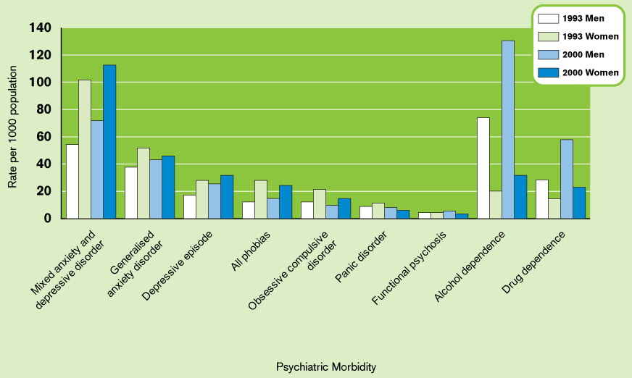
Prevalence of psychiatric disorders (per 1,000 population), by sex, England and Wales 1993 and 2000
Source: OPCS Surveys of Psychiatric Morbidity 1993 and 2000 See MHFA Manual p16
12
Notes:
As of August 2009, these figures are still the latest available from OPCS (Office of Population Censuses and Surveys) now part of ONS (The Office for National Statistics) . The expected update in 2007 is not available
“Psychiatric Morbidity “ = Mental Illness (morbidity = illness, mortality = death)
When discussing statistics, make the point that all statistics should be taken “with a pinch of salt”, ie exact definitions, survey methods, collection errors, etc all make a difference

Slide 14
Impact of mental health problems
Mental health problems are common - exact estimates vary
1 person in 4 will experience some form of mental health problem in any year (Goldberg, 1991)
At any given time 1 in 6 working age adults have symptoms associated with mental ill-health (eg sleep problems, fatigue, etc) which do not meet the criteria for diagnosis
A further 1 in 6 working age adults experience diagnosable mental health problems (eg depression, anxiety, etc) at any given time (The Royal College of Psychiatrists: Mental Health and Work 2008)
13
Notes:
The main message with statistics should be to give rough indications of magnitude. Try not to get drawn into discussions about spurious accuracy. Exact definitions vary. Research study methods vary, sample sizes vary, so statistical results will always vary.
Regional Public Health Observatories often have up-to-date statistics on the prevalence of mental health problems in the regions

Slide 15
What influences your mental health?
Some sources of stress
Physical
Environmental
Emotional
Acute life events
Chronic (long term) problems
Personal vulnerability
Psychological
Biological
19

Slide 16
Impact of mental health problems
Mental health problems are expensive
Total service costs - approx £22.5 billion in 2007 (Kings Fund, Paying the Price 2008)
Costs of lost employment - approx £26.1 billion (Kings Fund, as above)
Cost of reduced productivity whilst in work due to mental ill-health - approx £15 billion per year (Sainsbury Centre for Mental Health)
14
Notes:
“Service costs” include direct health and social care costs, and, where possible, informal care and criminal justice services

Slide 17
Six will become in-patients in psychiatric hospitals
24 of these will be referred to a specialist psychiatric service
102 of these will be diagnosed as having a mental health problem
230 of these will visit a GP
Around 250–300 people out of 1000 will experience
mental health problems every year in Britain
Source: based on figures from Goldberg and Huxley, Common Mental Disorders.
Notes:
Mention the concept of Recovery here – some of those not progressing upwards in this model have recovered
Importance of self help for many who don’t even go to GP, or reach threshold for psychiatric support

Slide 18
Factors that influence mental health and wellbeing
Stigma and discrimination
Physical illness
Physical disability
Poverty and deprivation
6 Strands of Inequality
16
Notes:
Talk about Anti Stigma campaigns here – Time to Change (www.time-to-change.org.uk), Shift (www.shift.org.uk)
6 Strands of Inequality are:
Race/Ethnicity
Disability
Gender
Age
Religion/Belief
Sexual Orientation
Instructors are encouraged to use a handout for participants on the Six Inequality Strands

Slide 19
What influences your mental health?
Some sources of stress
Physical
Environmental
Emotional
Acute life events
Chronic (long term) problems
Personal vulnerability
Psychological
Biological
19

Slide 20
A bucket full of stressors...
Example for young person
What’s in your stress bucket?
Poor housing
Staying out late clubbing and
not getting enough sleep
Stress of exams
Debts building up
Source: Brabben & Turkington 2002
20
Notes:
This is an opportunity to involve participants in thinking about stressors in their own lives
Key message: It is acceptable to talk about “stress”, but less acceptable to talk about “mental health/illness”
Key message: Some stress is good for us, but too much is damaging; and what is “too much” varies by individuals, and by time
Opportunity to mention stress/vulnerability model

Slide 21
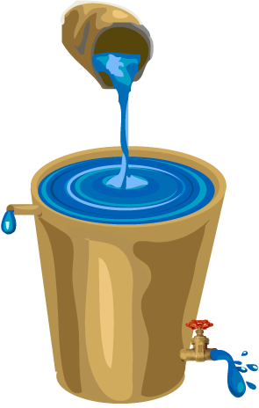
The Stress Tank
11
(C) Copyright 2000, Skip MacCarty, D.Min.

Slide 22
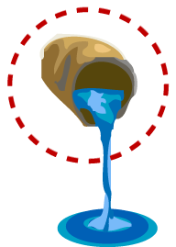
The Stress Tank
STRESSORS
Strain/Loss of Job Trouble Financially Relationship Conflict Excessive Change Sustained Illness Steady/Constant Worry Ordinary Hassles Recurring Irritations
11
(C) Copyright 2000, Skip MacCarty, D.Min.

Slide 23
The Stress Tank
11
OVERFLOW
Health Breakdown Accident Proneness Relationship Impairment Mental Illness
(C) Copyright 2000, Skip MacCarty, D.Min.

Slide 24
The Stress Tank
11
OVERFLOW
Health Breakdown Accident Proneness Relationship Impairment Mental Illness
(C) Copyright 2000, Skip MacCarty, D.Min.

Slide 25
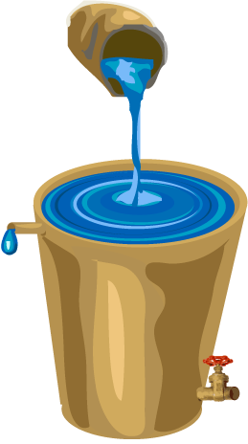
The Stress Tank
OPENING PRESSURE RELIEF VALVE
11
Prayer – Spiritual Centering Relaxation Exercise - Activity Viewpoint Eating Healthfully Neighborly Love Loyal Friendships – Loving Relationships Time Management - Organization
(C) Copyright 2000, Skip MacCarty, D.Min.

Slide 26
Depression
What is depression?
“… a loss of interest and enjoyment in ordinary things and experiences... low mood and a range of associated emotional, cognitive, physical and behavioural symptoms”
National Clinical Practice Guideline No 23 (NICE 2004)
22
Notes:
There are other definitions in DSM-IV (Diagnostic and Statistical Manual of Mental Disorders 1994, Fourth Edition , American Psychiatric Association)
and in ICD-10 (International Classification of Diseases, Classification of Mental and Behavioural Disorders 1992, World Health Organisation, Geneva).
However they are too long and detailed to be used on one slide.
The reference in the manual on page 25 (and in the first version of the slides) to clinical depression lasting at least two weeks, is still relevant and important, but in fact most episodes of depression last several months (average 9 months, rarely less than 6 months, sometimes a year or longer). The two week reference is for clinical diagnosis only

Slide 27
Symptoms of depression
Emotions
Sadness, anxiety, guilt, anger, mood swings, lack of emotional responsiveness, helplessness, hopelessness
Thoughts
Frequent self-criticism, self-blame, worrying, pessimism, impaired memory and concentration, difficulty making decisions, confusion, tendency to believe that others see you in a negative light, thoughts of death and suicide
23

Slide 28
Symptoms of depression (contd)
Behaviour
Crying spells, withdrawal from others, neglect of responsibilities, loss of interest in personal appearance, loss of motivation
Physical
Chronic fatigue, lack of energy, sleeping too much or too little, overeating or loss of appetite, constipation, weight loss or gain, irregular menstrual cycle, loss of libido, unexplained aches and pains
24

Slide 29
Risk factors for depression
Distressing and uncontrollable event
Exposure to stressful life events
Persistent (ongoing) stress and anxiety
Loss of a job and difficulty finding a new one
Pregnancy and having a baby
Some medical conditions
Stress of having another mental health problem
Illness which is life-threatening, chronic or associated with pain
25

Slide 30
Risk factors for depression (contd)
Hormonal changes in women at different times and stages of life
Lack of exposure to bright light in winter
Family history of depression
Having a previous episode of depression
A difficult childhood, including an early and unsupported bereavement
26

Slide 31
Possible signs and symptoms of depression in the workplace
Decreased productivity
Morale problems
Lack of co-operation
Safety problems
Absenteeism
Frequent complaints of being tired all the time
Complaints of unexplained aches and pains
Alcohol and/or other drug misuse
27
Notes:
Useful to refer to the Shift Line Managers’ Web Resource at this point – free to download from the Shift website, www.shift.org.uk
Shift also have a Resource Review Panel which recommends resources, many available on the website, for use with employers

Slide 32
Domestic Violence

Slide 33
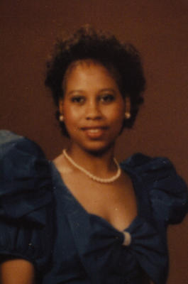
This is Carolyn Thomas before her face was destroyed in a shooting.

Slide 34
Terrence Kelly leaves court April 15, 2005, in Waco. He was convicted of shooting Carolyn Thomas in the face and killing her mother in 2003. He is serving a life sentence.

Slide 35
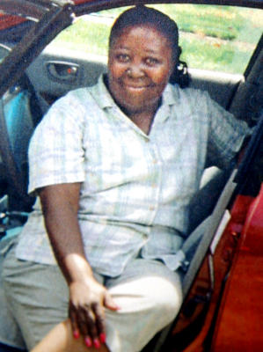
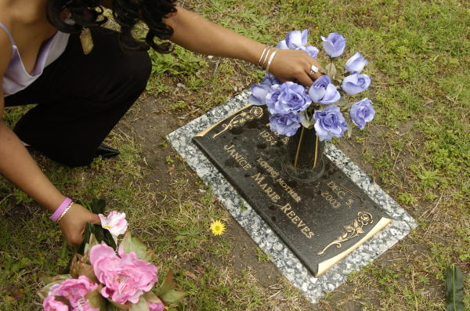
This photo shows Janice Reeves, Carolyn Thomas' mother, who was shot dead by her daughter's boyfriend in 2003.

Slide 36
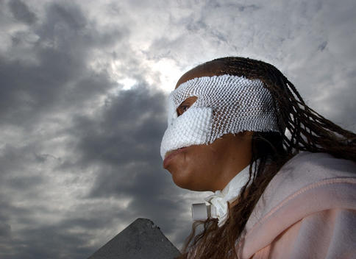
Carolyn Thomas, a 34-year-old former track star was shot in the face by an abusive ex-boyfriend who also killed her mother. She wears a mask-like bandage to protect her from infection and the stares of those who are unknowing of her experiences.

Slide 37
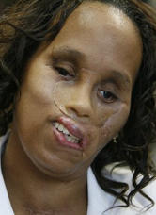
Life Begins Anew!

Slide 38
NATURE VS NURTURE

Slide 39
Strong, healthy families enjoy spending time together.

Slide 40
Some years ago, a young man was born into an unloving home that had NO TIME for him. . .

Slide 41
Lee Harvey Oswald

Slide 42
Research—Disconnected Children
A University of Michigan study indicates that children are becoming increasingly DISCONNECTED from their parents and from their churches.

Slide 43
Research—Less Family Outings
Family Vacations 28% less in 20 years.
Outdoor nature activities 50% less
Less Communication between Parent-Child

Slide 44
Research—Less Eating together
In the past 30 years families dined together 33% less

Slide 45
Research—Increase Porn Games
Increased children’s exposure to M-rated games
61% of children own M-rated games
Nat’l Institute on Media & the Family, 2005

Slide 46
Research—TV is Background of our Lives
• 65% children live where TV is running half the time
• 36% of homes leave TV on all day
Kaiser Family Foundation, 2003
Notes:
www.photostogo.com

Slide 47
Research—Infants and TV
43%, age 0-2, watch daily
26% have TV in their own room
“Much new media is being targeted at infants and toddlers.”
Kaiser Family Foundation, 2003
Notes:
"© Photographer: Mikhail Tolstoy | Agency: Dreamstime.com"

Slide 48
“Today, the average child watches 7 hours of TV per day…
By the end of grade school he’s seen over 8,000 murders and 100,000 acts of violence.”
Robert G. DeMoss, Jr., Learn to Discern, Zondervan, 1992, p. 52

Slide 49
Meanwhile “he’s spent an average of 5 minutes a day with his father and 20 minutes with his mother, and most of that time was spent either eating or watching TV!”
DeMoss, Learn to Discern ,p. 14

Slide 50
TV and Aggression
“When children see televised violence, they may … come to view aggression as acceptable behavior. Most violent programs do not show victims suffering or perpetrators being punished. On the contrary, they glorify and glamorize violence.”
Dr. Diane Papalia, Univ of Wisconsin, Human Development
Notes:
www.photostogo.com

Slide 51
Research—Porn and Internet
Adult porn sites 63 million visitors Dec 05
20% of children using chat rooms approached by pedophiles
Family Safe Media

Slide 52
Ben Carson had a mother who was a “hands-on” parent

Slide 53
One father decided that his boys were spending too much time with television and video games. He thought, If I take television away from them, I must replace it with something better.

Slide 54
Father decides what will be his time priorities

Slide 55
The Current Scene
The number of fathers not sharing priority time with their growing sons and daughters has been increasing.
How is it in your home?

Slide 56
Daily set a few attainable important goals and accomplish them.

Slide 57
SUMMARY
Strong Families spend large chunks of time together.

Slide 58
Kids need parent’s time.

Slide 59
NATURE VS NURTURE

Slide 60
Are there any questions?

Slide 61
TOMORROW’S TOPIC :
TRUSTING IN A DIVINE POWER

Slide 62
God bless you!

